Slide 1
LibreOffice Python Part 1
Setting up LibreOffice to provide Python scripting.
Other parts of this presentation:
Part 2: Write a python program located in the User Library.
Part 3: Move a python program from the User to the Shared Library.
Part 4: Embed a User library python program in the Document Library.
Hamilton Python User Group Presentation
2015 April 13
Ian Stewart
V1.0
https://github.com/hampug

Slide 2
Step1: Check python3 is available...
If no python then install it...
>>>
~/==> python3
Python 3.4.0 (default, Apr 11 2014, 13:05:11)
[GCC 4.8.2] on linux
Type "help", "copyright", "credits" or "license" for more information.
>>>
~/==> sudo apt-get install python3

Slide 3
Step2: Check if python3-uno is available...
If no python3-uno then install it...
~/==> python3
Python 3.4.0 (default, Apr 11 2014, 13:05:11)
[GCC 4.8.2] on linux
Type "help", "copyright", "credits" or "license" for more information.
>>> import uno
>>> dir(uno)
['Any', 'Bool', 'ByteSequence', 'Char', 'Enum', 'Type', '__builtin__', '__builtins__', '__cached__', '__doc__', '__file__', '__loader__', '__name__', '__package__', '__spec__', '_g_ctx', '_g_delegatee', '_impl_extractName', '_uno_extract_printable_stacktrace', '_uno_import', '_uno_struct__eq__', '_uno_struct__getattr__', '_uno_struct__init__', '_uno_struct__repr__', '_uno_struct__setattr__', '_uno_struct__str__', 'absolutize', 'createUnoStruct', 'fileUrlToSystemPath', 'generateUuid', 'getClass', 'getComponentContext', 'getConstantByName', 'getCurrentContext', 'getTypeByName', 'invoke', 'isInterface', 'os', 'pyuno', 'setCurrentContext', 'socket', 'sys', 'systemPathToFileUrl', 'unicode']
>>>
~/==> sudo apt-get install python3-uno

Slide 4
What is python3-uno?
https://packages.debian.org/sid/python3-uno
The Python-UNO bridge allows use of the standard LibreOffice API with the Python scripting language. It additionally allows others to develop UNO components in Python, thus Python UNO components may be run within the LibreOffice process and can be called from C++ or the built in StarBasic scripting language.
Also see...
http://api.libreoffice.org/examples/DevelopersGuide/examples.html
https://wiki.openoffice.org/wiki/Python_as_a_macro_language

Slide 5
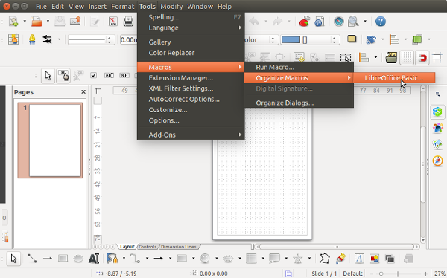
Step3: Is Python macro scripting available? Maybe there is only the integrated Basic marco scripting?

Slide 6
Step3: Installing the LibreOffice script provider for python
~/==> sudo apt-get install libreoffice-script-provider-python
Reading package lists... Done
Building dependency tree
Reading state information... Done
The following packages were automatically installed and are no longer required:
python3-mccabe python3-pep8
Use 'apt-get autoremove' to remove them.
The following NEW packages will be installed:
libreoffice-script-provider-python
0 upgraded, 1 newly installed, 0 to remove and 361 not upgraded.
Need to get 30.1 kB of archives.
After this operation, 218 kB of additional disk space will be used.
Get:1 http://nz.archive.ubuntu.com/ubuntu/ trusty-updates/universe libreoffice-script-provider-python all 1:4.2.7-0ubuntu2 [30.1 kB]
Fetched 30.1 kB in 0s (132 kB/s)
Selecting previously unselected package libreoffice-script-provider-python.
(Reading database ... 378604 files and directories currently installed.)
Preparing to unpack .../libreoffice-script-provider-python_1%3a4.2.7-0ubuntu2_all.deb ...
Unpacking libreoffice-script-provider-python (1:4.2.7-0ubuntu2) ...
Setting up libreoffice-script-provider-python (1:4.2.7-0ubuntu2) ...
~/==>

Slide 7
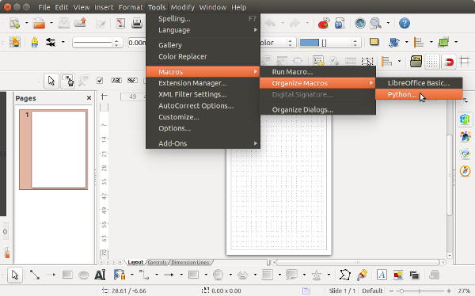
Python macro scripting is now available...
Finished setup steps. Click on “Python...”
...and lets see if there are any example python programs.

Slide 8
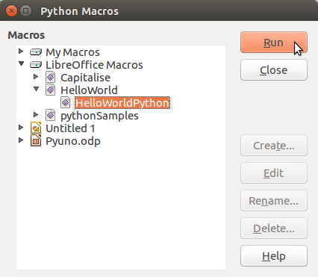
The “LibreOffice Macros” Shared library contains three sample python programs.
Run the HelloWorldPython() python function that is in the file “HelloWorld.py”

Slide 9
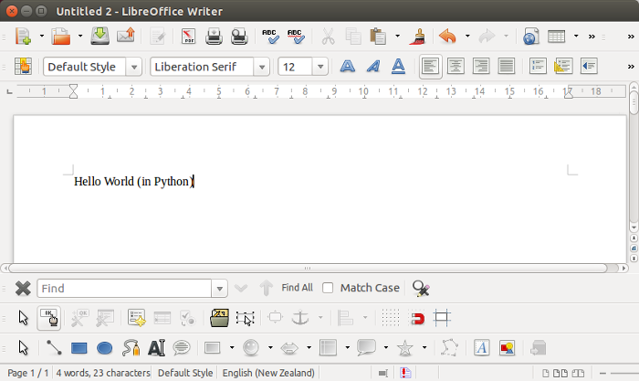
The HelloWorldPython() python function that is in the file “HelloWorld.py” created a new Write document and inserted some text...

Slide 10
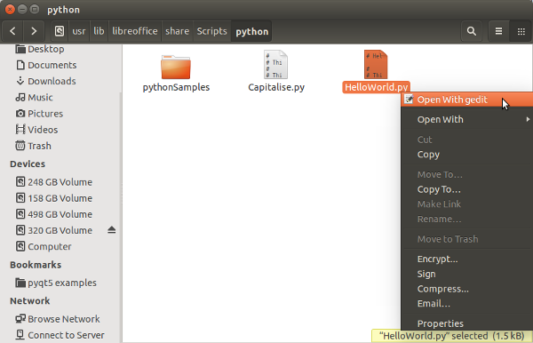
Review of the example python program files in the Shared library...
Shared library path: usr/lib/libreoffice/share/Scripts/python

Slide 11
HelloWorld.py with the function “HelloWorldPython():”...
…Enough of the provided programs in the Shared library. Time to write our own python program in the User library...
# HelloWorld python script for the scripting framework
#
# This file is part of the LibreOffice project.
def HelloWorldPython( ):
"""Prints the string 'Hello World(in Python)' into the current document"""
#get the doc from the scripting context which is made available to all scripts
desktop = XSCRIPTCONTEXT.getDesktop()
model = desktop.getCurrentComponent()
#check whether there's already an opened document. Otherwise, create a new one
if not hasattr(model, "Text"):
model = desktop.loadComponentFromURL(
"private:factory/swriter","_blank", 0, () )
#get the XText interface
text = model.Text
#create an XTextRange at the end of the document
tRange = text.End
#and set the string
tRange.String = "Hello World (in Python)"
return None

Slide 12
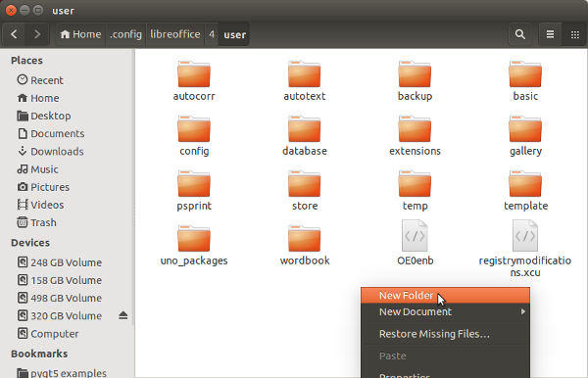
Create the User library for python. Create a “Scripts” folder in ~/.config/libreoffice/4/user/...
User Library for Basic exists by default.
User library is best for developing a python program. Programs written and debugged in the User library can be moved to another library later.

Slide 13
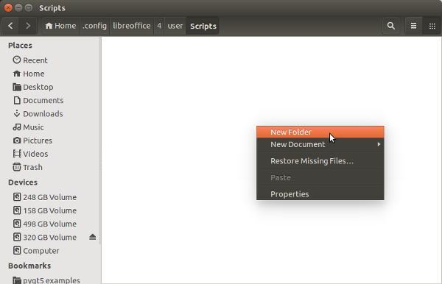
Create the “python” folder in “Scripts” folder...

Slide 14
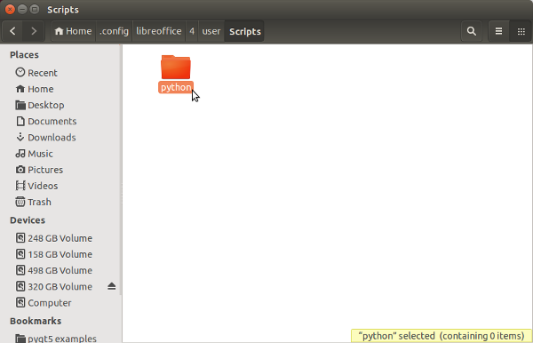
Go into the python folder...

Slide 15
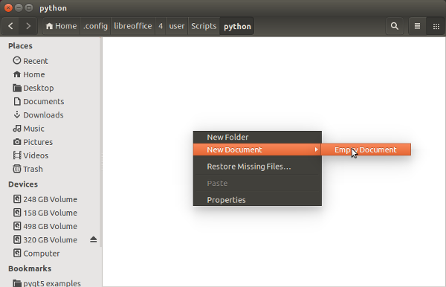
Create a helloworld.py file in the python folder

Slide 16
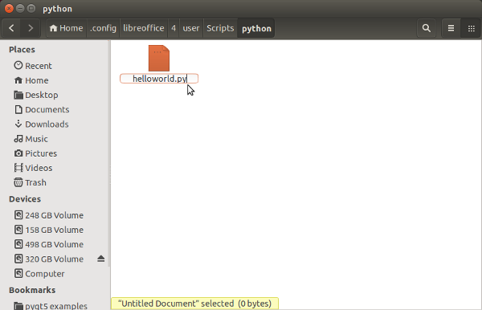
Edit the empty helloworld.py file...
Path to python file:
~/.config/libreoffice/4/user/Scripts/python/helloworld.py

Slide 17
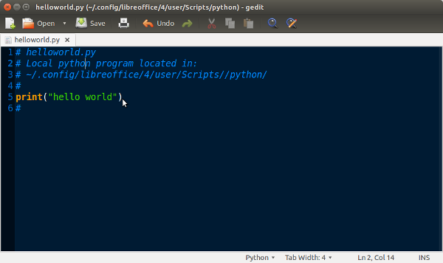
Write a python program...

Slide 18
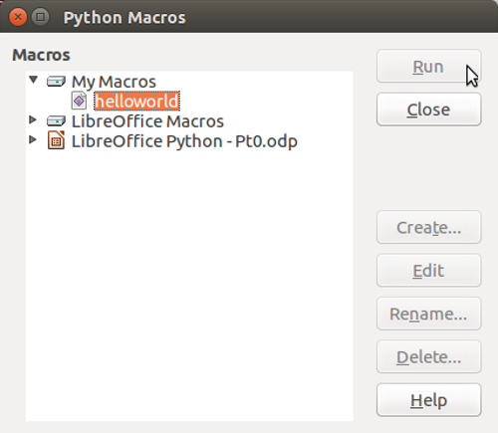
Helloworld.py is now displayed in the User library “My Macros”...
...but, because helloworld has no functions() it won't Run...
Run not highlighted... huh?
Create, Edit, Rename and Delete are not hightlighted as they can only be used by the Basic Integrated Development Environment.

Slide 19
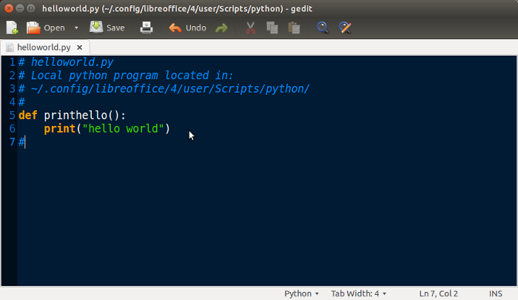
Edit python program to create the function printhelllo(): ...

Slide 20
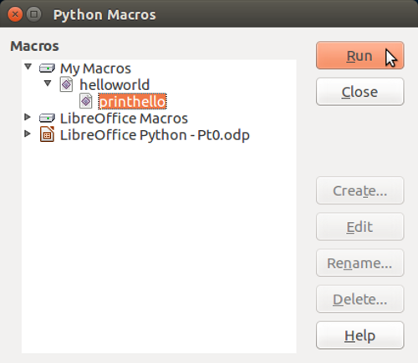
Helloworld.py is now displayed in the User library “My Macros” with the function printhello() hightlighted and it can be Run...
...it Runs, but there is no console terminal to view stdout, so you don't see any “hello world” :-(

Slide 21
End of Part 1
Goto Part 2 to write a python program in the User library that will run and provides output that is visible.

Slide 22
PS:
Observation: Python2 doesn't import uno but python3 does...
Homework: Have a look at the file...
/usr/lib/libreoffice/program/pythonscript.py ...which contains the line:
GLOBAL_SCRIPTCONTEXT_NAME = "XSCRIPTCONTEXT"
In the future your python scripts are likely to be using... XSCRIPTCONTEXT.getDesktop() and/or
XSCRIPTCONTEXT.getDocument()
~/==> python
Python 2.7.6 (default, Mar 22 2014, 22:59:56)
[GCC 4.8.2] on linux2
Type "help", "copyright", "credits" or "license" for more information.
>>> import uno
Traceback (most recent call last):
File "<stdin>", line 1, in <module>
ImportError: No module named uno
>>>
~/==> python3
Python 3.4.0 (default, Apr 11 2014, 13:05:11)
[GCC 4.8.2] on linux
Type "help", "copyright", "credits" or "license" for more information.
>>> import uno
>>>

